Slide 1
Approximating solutions to higher-order initial-value problems

Slide 2
Introduction
In this topic, we will
  Discuss 2nd-order initial-value problems (ivps)
  Explain how to reformulate a 2nd-order ivp into a system of two 1st-order ivps
  Look at an example
  Consider a 5th-order ivp
  Reformulate that ivp into a system of five 1st-order ivps

Slide 3
2nd-order initial-value problems
You have seen 2nd-order initial-value problems (ivps) written in the form:
Based on the implicit function theorem,
we can always write a higher-order ivp as

Slide 4
2nd-order initial-value problems
Consequently, a second-order ivp can be written as
Now, we don’t know y(t), nor do we know y⁽¹⁾(t)
  Thus, suppose we define
  w₀(t) = y(t) w₁(t) = y⁽¹⁾(t)
  Note therefore that

Slide 5
2nd-order initial-value problems
Consequently, a second-order ivp can be written as a system of
two 1st-order ivps
In the last topic, we saw how we can write this with vectors

Slide 6
2nd-order initial-value problems
For example,
In the last topic, we saw how we can write this with vectors
      vec<2> F( double t, vec<2> w ) {
      return vec<2>{ w[1],
      f( t, w ) };
      }
      // y"(t) = 2y'(t) - y(t) + sin(t)
      double f( double t, vec<2> w ) {
      return 2*w[1] - w[0] + sin(t);
      }

Slide 7
2nd-order initial-value problems
Consider the following:
In the last topic, we saw how we can write this with vectors
    vec<2> F( double t, vec<2> w ) {
    return vec<2>{ w[1],
    -2*w[1] - w[0] + std::sin(t) } };
    }

Slide 8
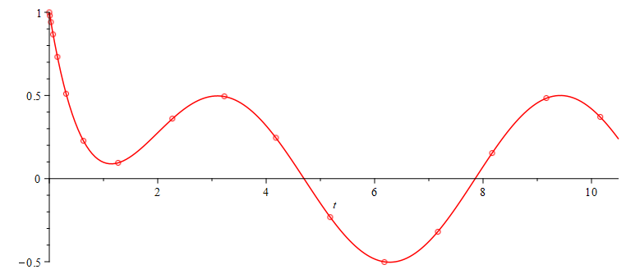
2nd-order initial-value problems
The solution and our approximation is shown here:

Slide 9
2nd-order initial-value problems
The output of the Dormand-Prince method is:
    0 < 1 -2>
    0.01 < 0.9801495012466744 -1.970149501662508 >
    0.03 < 0.9413366004450955 -1.911336633992595 >
    0.07 < 0.8671814460390597 -1.797182432449922 >
    0.15 < 0.7321233276597681 -1.582143788605167 >
    0.31 < 0.5103193853011617 -1.200680330337188 >
    0.63 < 0.2271084350598108 -0.6028457398035203 >
    1.27 < 0.09484159082902341 0.09414765884974807>
    2.27 < 0.360724134043294 0.29190279275873 >
    3.22870270906355 < 0.4949570390741321 -0.06046514781695389>
    4.180454048644937 < 0.2454653632568291 -0.4306789648656997 >
    5.180454048644937 <-0.2319093306500261 -0.4427291816128475 >
    6.180454048644937 <-0.5018483904660588 -0.04756916700176944>
    7.167318861458502 <-0.3196352998086384 0.3892455074943849 >
    8.167318861458501 < 0.1533886469424242 0.4763189756994295 >
    9.167318861458501 < 0.4843038344873439 0.1262539232541798 >
    10.16224322948684 < 0.3711291770716665 -0.3375822706119238 >

Slide 10
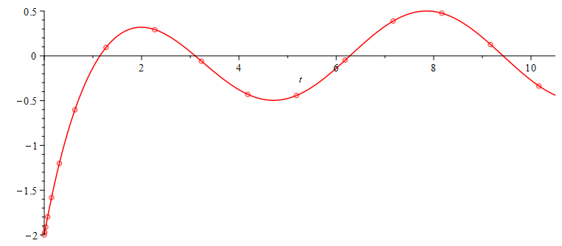
2nd-order initial-value problems
The solution and our approximation is shown here:

Slide 11
Higher-order initial-value problems
The process is the same for a higher-order ivp:
This is the function:
    vec<5> F( double t, vec<5> w ) {
    return vec<5>{
    w[1],
    w[2],
    w[3],
    w[4],
    (std::cos(t) - 17.5 *w[4] - 132.625*w[3]
    - 128.95 *w[2] - 136.25 *w[1]
    - 91.304*w[0])/12.5
    };
    }

Slide 12
Higher-order initial-value problems
This piece of code would print the appropriate output
    int main() {
    auto result{ dp45(
    F, std::make_pair( 0.0, 10.0 ),
    vec<N>{ 1.0, -0.8, 0.7, 0.6, -0.5 },
    std::make_pair( 1e-4, 1.0 ), 1e-2
    ) };
    std::cout << "n = " << std::get<0>( result ) << std::endl;
    for ( unsigned int k{0}; k <= std::get<0>( result ); ++k ) {
    std::cout << std::get<1>( result )[k] << ", "
    << std::get<2>( result )[k] << std::endl;
    }
    return 0;
    }

Slide 13
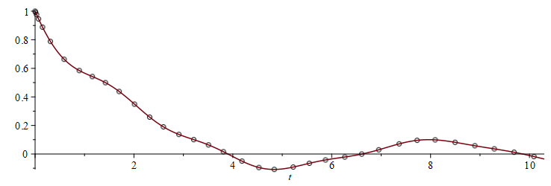
Higher-order initial-value problems
This is the solution to this 5th-order ivp and our approximations

Slide 14
Summary
Following this topic, you now
  Have a better understanding of 2nd- and higher-order initial-value problem
  Understand how we can reformulate an n^{th}-order ivp into a system of n 1st-order ivps
  Have seen examples of a 2nd- and a 5th-order ivp

Slide 15
References
[1] https://en.wikipedia.org/wiki/Initial_value_problem

Slide 16
Acknowledgments
None so far.

Slide 17



Colophon
These slides were prepared using the Cambria typeface. Mathematical equations use Times New Roman, and source code is presented using Consolas. Mathematical equations are prepared in MathType by Design Science, Inc.
Examples may be formulated and checked using Maple by Maplesoft, Inc.
The photographs of flowers and a monarch butter appearing on the title slide and accenting the top of each other slide were taken at the Royal Botanical Gardens in October of 2017 by Douglas Wilhelm Harder. Please see
https://www.rbg.ca/
for more information.

Slide 18
Disclaimer
These slides are provided for the ece 204 Numerical methods course taught at the University of Waterloo. The material in it reflects the author’s best judgment in light of the information available to them at the time of preparation. Any reliance on these course slides by any party for any other purpose are the responsibility of such parties. The authors accept no responsibility for damages, if any, suffered by any party as a result of decisions made or actions based on these course slides for any other purpose than that for which it was intended.

